Slide 1
Lecture
Accounting for Merchandising Operations
4
L.O. 5-1: Merchandising operations and inventory systems
L.O. 5-2: Recording purchases under a perpetual system
L.O. 5-3: Recording sales under a perpetual system
L.O. 5-4: The Accounting Cycle for a Merchandising Company
L.O. 5-5: Multiple-Step Income Statement

Slide 2
Learning Objective 5-1
Merchandising Operations and Inventory Systems

Slide 3
Outline
Merchandising operations
Operating cycles
Flow of costs

Slide 4
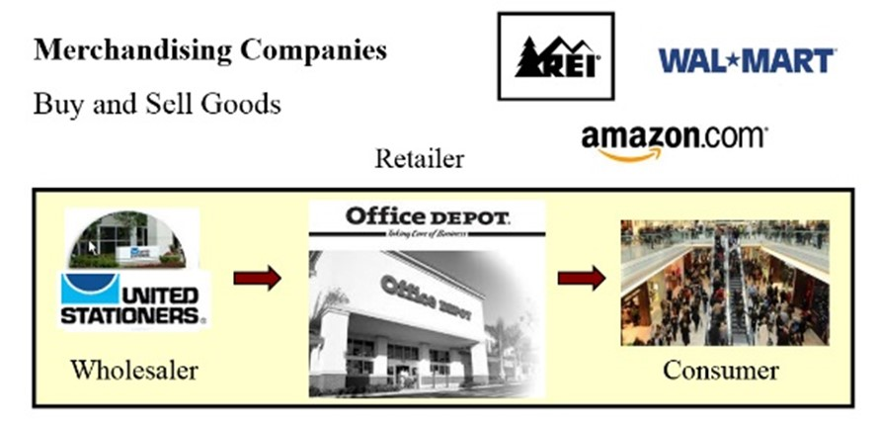
Merchandising Operations
The primary source of revenues is referred to as sales revenue or sales.
L O 1

Slide 5
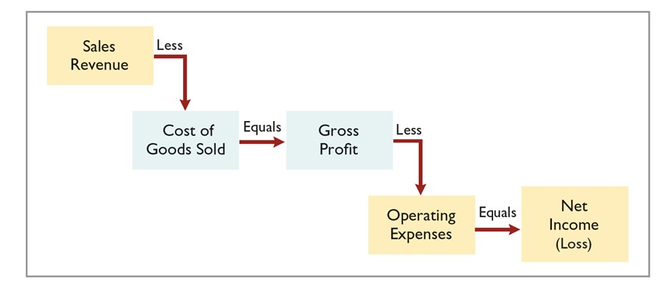
Merchandising Operations
Cost of goods sold is the total cost of merchandise sold during the period.
L O 1

Slide 6
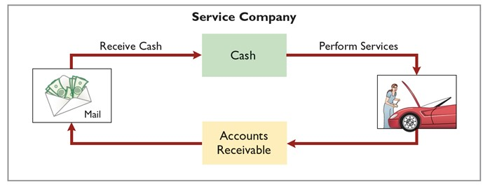
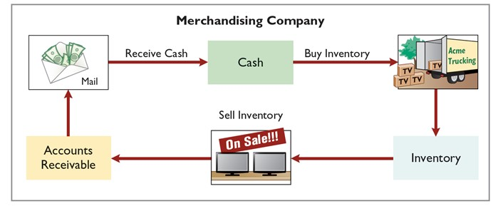
Operating Cycles
The operating cycle of a merchandising company ordinarily is longer than that of a service company.
L O 1

Slide 7
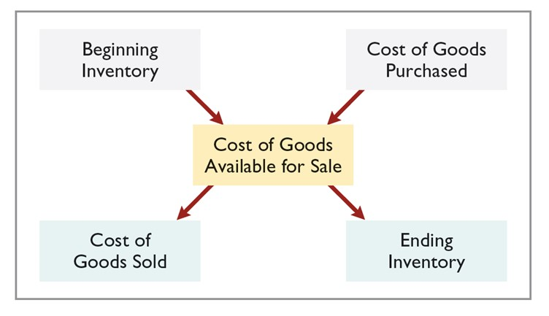
Flow of Costs Perpetual System or Periodic System for Costing Inventory
Companies use either a perpetual inventory system or a periodic inventory system to account for inventory.
L O 1

Slide 8
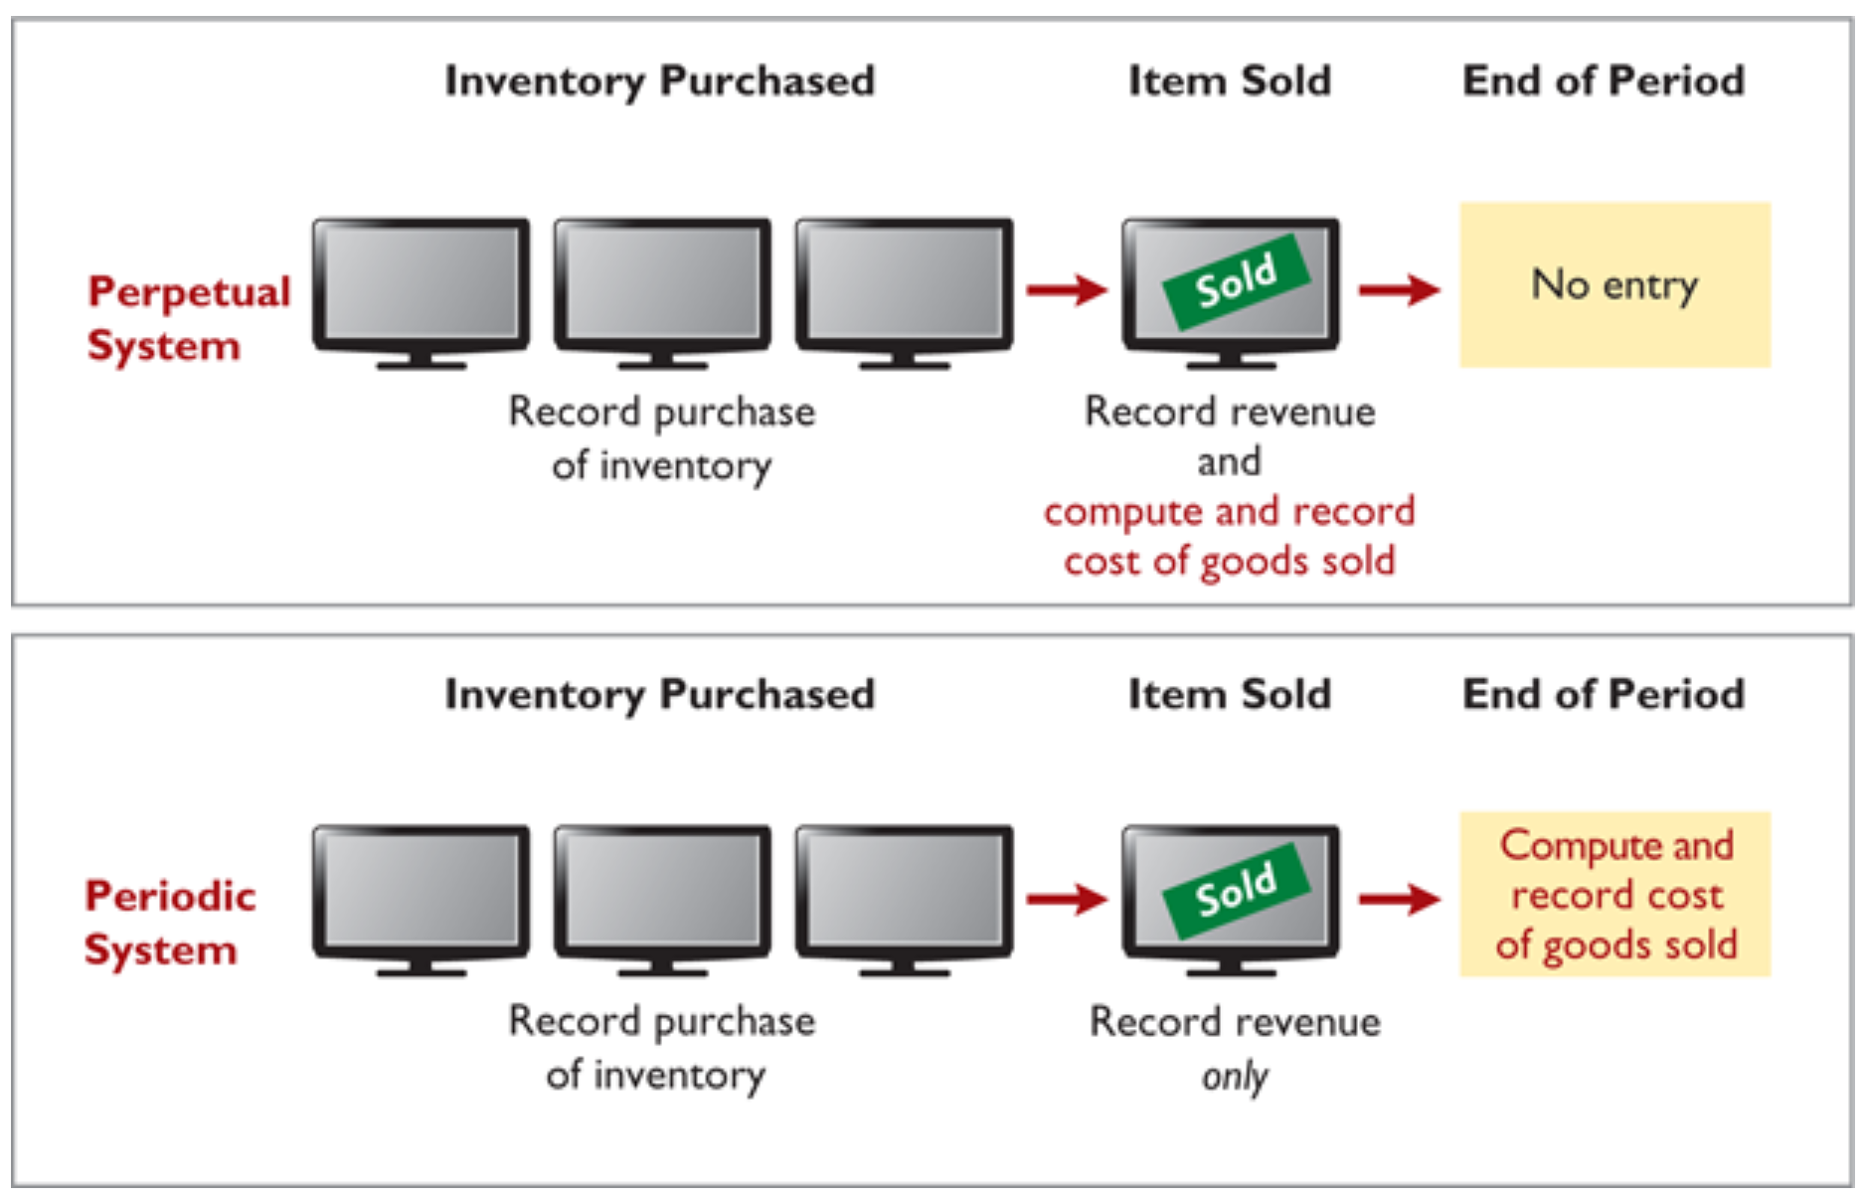
Flow of Costs Perpetual System or Periodic System for Costing Inventory
L O 1

Slide 9
Flow of Costs Perpetual System
Maintains detailed records of the cost of each inventory purchase and sale.
Records continuously show inventory that should be on hand for every item.
Company determines cost of goods sold each time a sale occurs.
L O 1

Slide 10
Flow of Costs Periodic System
Do not keep detailed records of the goods on hand.
Cost of goods sold determined by count at the end of the accounting period.
Calculation of Cost of Goods Sold:
Beginning inventory | $ 100,000
Add: Purchases, net | 800,000
Goods available for sale | 900,000
Less: Ending inventory | 125,000
Cost of goods sold | $775,000
L O 1

Slide 11
Flow of Costs Advantages of the Perpetual System
Traditionally used for merchandise with high unit values.
Shows the quantity and cost of the inventory that should be on hand at any time.
Provides better control over inventories than a periodic system.
L O 1

Slide 12
DO IT! 1: Merchandising Operations and Inventory Systems
Indicate whether the following statements are true or false:
The primary source of revenue for a merchandising company results from performing services for customers.
False
The operating cycle of a service company is usually shorter than that of a merchandising company.
True
Sales revenue less cost of goods sold equals gross profit.
True
Ending inventory plus the cost of goods purchased equals cost of goods available for sale.
False
L O 1

Slide 13
Learning Objective 5-2
Recording Purchases Under a Perpetual System

Slide 14
Outline
Recording purchases of merchandise
Freight costs
Purchase returns and allowances
Purchase discounts

Slide 15
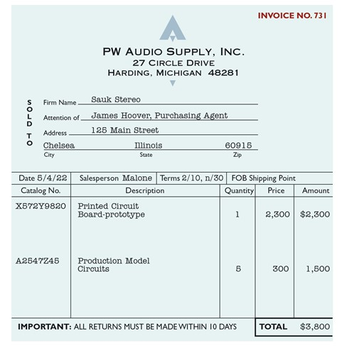
Recording Purchases of Merchandise
Made using cash or credit (on account).
Normally record when goods are received from the seller.
Purchase invoice should support each credit purchase.
L O 2

Slide 16
Recording Purchases of Merchandise
Illustration: Sauk Stereo (the buyer) uses as a purchase invoice the sales invoice prepared by PW Audio Supply, Inc. (the seller). Prepare the journal entry for Sauk Stereo for the invoice from PW Audio Supply.
May 4 | Inventory | 3,800
 | Accounts Payable |  | 3,800
L O 2

Slide 17
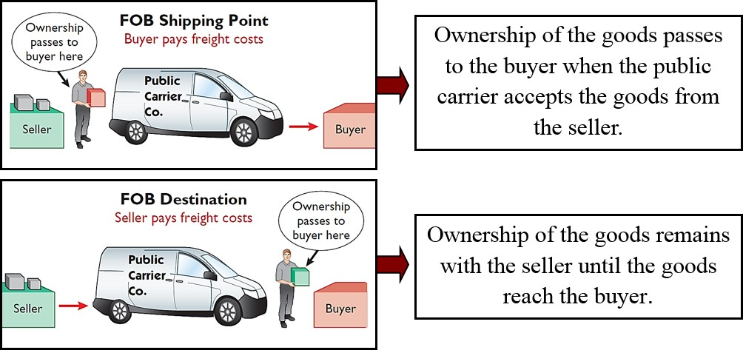
Freight Costs
L O 2

Slide 18
Freight Costs Illustration
Assume upon delivery of the goods on May 6, Sauk Stereo pays Public Carrier Company $150 for freight charges, the entry on Sauk Stereo’s books is:
May 6 | Inventory | 150
 | Cash |  | 150
Assume the freight terms on the invoice had required PW Audio Supply to pay the freight charges of $150, the entry by PW Audio Supply would have been:
May 4 | Freight-Out (or Delivery Expense) | 150
 | Cash |  | 150
L O 2

Slide 19
Purchase Returns and Allowances
Purchaser may be dissatisfied because goods are damaged or defective, of inferior quality, or do not meet purchaser’s specifications.
Purchase Return
Return goods for credit if the sale was made on credit, or for a cash refund if the purchase was for cash.
Purchase Allowance
May choose to keep the merchandise if the seller will grant a reduction from the purchase price.
L O 2

Slide 20
Purchase Returns and Allowances Illustration
Assume Sauk Stereo returned goods costing $300 to P W Audio Supply on May 8.
May 8 | Accounts Payable | 300
 | Inventory |  | 300
L O 2

Slide 21
Purchase Returns and Allowances Review Question
In a perpetual inventory system, a return of defective merchandise by a purchaser is recorded by crediting:
a. Purchases
b. Purchase Returns
c. Purchase Allowance
d. Inventory
L O 2

Slide 22
Purchase Discounts
Credit terms may permit buyer to claim a cash discount for prompt payment.
Advantages:
Purchaser saves money.
Seller shortens the operating cycle by converting its accounts receivable into cash more quickly.
Example: Credit terms may read 2/10, n/30.
L O 2

Slide 23
Purchase Discounts Credit Terms
2/10, n/30 | 1/10 EOM | n/10 EOM
2% discount if paid within 10 days, otherwise net amount due within 30 days. | 1% discount if paid within first 10 days of next month. | Net amount due within the first 10 days of the next month.
L O 2

Slide 24
Purchase Discounts Illustration
Assume Sauk Stereo pays the balance due of $3,500 (gross invoice price of $3,800 less purchase returns and allowances of $300) on May 14, the last day of the discount period. Prepare the journal entry Sauk Stereo makes on May 14 to record the payment.
May 14 | Accounts Payable | 3,500
 | Cash |  | 3,430
 | Inventory |  | 70
 | (Discount = $3,500 × 2% = $70)
L O 2

Slide 25
Purchase Discounts Illustration (Continued)
If Sauk Stereo failed to take the discount, and instead made full payment of $3,500 on June 3, the journal entry would be:
June 3 | Accounts Payable | 3,500
 | Cash |  | 3,500
L O 2

Slide 26
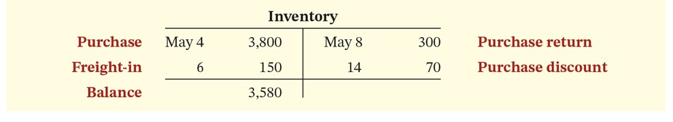
Summary of Purchasing Transactions
L O 2

Slide 27
DO IT! 2: Purchase Transactions
On September 5, De La Hoya Company buys merchandise on account from Junot Diaz Company. The purchase price of the goods paid by De La Hoya is $1,500, and the cost to Diaz Company was $800. On September 8, De La Hoya returns defective goods with a selling price of $200. Record the transactions on the books of De La Hoya Company.
Sept. 5 | Inventory | 1,500
 | Accounts Payable |  | 1,500
8 | Accounts Payable | 200
 | Inventory |  | 200
L O 2

Slide 28
Learning Objective 5-3
Recording Sales Under a Perpetual System

Slide 29
Outline
Recording sales of merchandise
Sales returns and allowances
Sales discounts

Slide 30
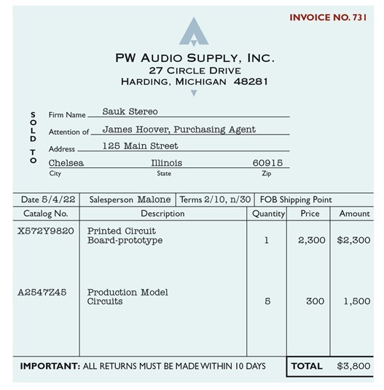
Recording Sales of Merchandise
Made using cash or credit (on account).
Sales revenue, like service revenue, is recorded when the performance obligation is satisfied.
Performance obligation is satisfied when the goods are transferred from the seller to the buyer.
Sales invoice should support each credit sale.
L O 3

Slide 31
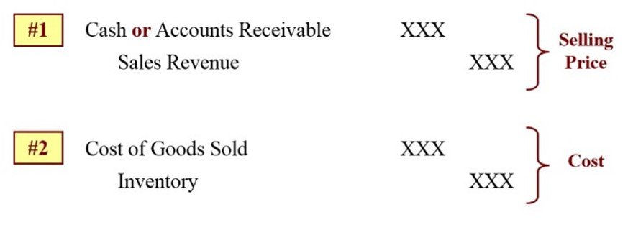
Recording Sales of Merchandise Journal Entries to Record a Sale
L O 3

Slide 32
Recording Sales of Merchandise Illustration
PW Audio Supply records the sale of $3,800 on May 4 to Sauk Stereo on account as follows (assume the merchandise cost PW Audio Supply $2,400).
May 4 | Accounts Receivable | 3,800
 | Sales Revenue |  | 3,800
4 | Cost of Goods Sold | 2,400
 | Inventory |  | 2,400
L O 3

Slide 33
Sales Returns and Allowances
“Flip side” of purchase returns and allowances.
Contra-revenue account to Sales Revenue (debit).
Sales not reduced (debited) because:
Would obscure the relative importance of sales returns and allowances as a percentage of sales.
Could distort comparisons between total sales in different accounting periods.
L O 3

Slide 34
Sales Returns and Allowances Illustration
Prepare the entry PW Audio Supply would make to record the credit for returned goods on May 8 that had a $300 selling price (assume a $140 cost). Assume the goods were not defective.
May 8 | Sales Returns and Allowances | 300
 | Accounts Receivable |  | 300
8 | Inventory | 140
 | Cost of Goods Sold |  | 140
L O 3

Slide 35
Sales Returns and Allowances Another Illustration
Assume the returned goods were defective and had a fair value of $50, PW Audio would make the following entries:
May 8 | Sales Returns and Allowances | 300
 | Accounts Receivable |  | 300
8 | Inventory | 50
 | Cost of Goods Sold |  | 50
L O 3

Slide 36
Sales Returns and Allowances Review Question
The cost of goods sold is determined and recorded each time a sale occurs in:
periodic inventory system only.
a perpetual inventory system only.
both a periodic and perpetual inventory system.
neither a periodic nor perpetual inventory system.
L O 3

Slide 37
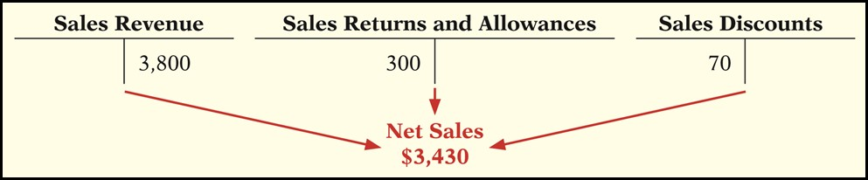
Sales Discount
Offered to customers to promote prompt payment of the balance due.
Contra-revenue account (debit) to Sales Revenue.
L O 3

Slide 38
Sales Discount Illustration
Assume Sauk Stereo pays the balance due of $3,500 (gross invoice price of $3,800 less purchase returns and allowances of $300) on May 14, the last day of the discount period. Prepare the journal entry PW Audio Supply makes to record the receipt on May 14.
May 14 | Cash | 3,430
 | Sales Discounts | 70*
 | Accounts Receivable |  | 3,500
*[($3,800 − $300) × 2%]
L O 3

Slide 39
DO IT! 3: Sales Transactions
On September 5, De La Hoya Company buys merchandise on account from Junot Diaz Company. The selling price of the goods is $1,500, and the cost to Diaz Company was $800. On September 8, De La Hoya returns defective goods with a selling price of $200 and a fair value of $30. Record the transactions on the books of Junot Diaz Company.
Sept. 5 | Accounts Receivable | 1,500
 | Sales Revenue |  | 1,500
5 | Cost of Goods Sold | 800
 | Inventory |  | 800
L O 3

Slide 40
DO IT! 3: Sales Transactions (Continued)
On September 5, De La Hoya Company buys merchandise on account from Junot Diaz Company. The selling price of the goods is $1,500, and the cost to Diaz Company was $800. On September 8, De La Hoya returns defective goods with a selling price of $200 and a fair value of $30. Record the transactions on the books of Junot Diaz Company.
Sept. 8 | Sales Returns and Allowances | 200
 | Accounts Receivable |  | 200
8 | Inventory | 30
 | Cost of Goods Sold |  | 30
L O 3

Slide 41
Learning Objective 5-4
The Accounting Cycle for a Merchandising Company

Slide 42
Outline
Adjusting entries
Closing entries

Slide 43
Adjusting Entries
Generally the same as a service company.
One additional adjustment to make the records agree with the actual inventory on hand.
Involves adjusting Inventory and Cost of Goods Sold.
L O 4

Slide 44
Adjusting Entries
Illustration: Suppose that PW Audio Supply has an unadjusted balance of $40,500 in Merchandise Inventory. Through a physical count, PW Audio determines that its actual merchandise inventory at year-end is $40,000. On December 31 the company would make an adjusting entry as follows.
Dec. 31 | Cost of Goods Sold | 500
 | Inventory |  | 500
L O 4

Slide 45
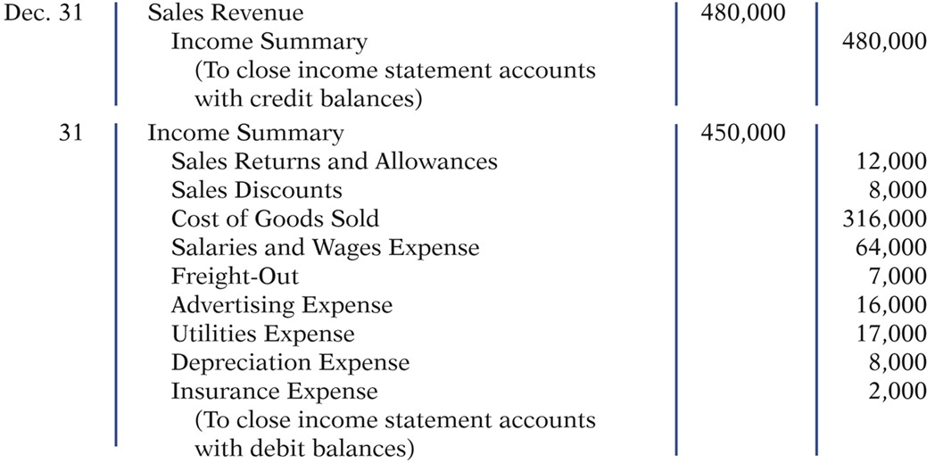
Closing Entries Close revenue and expense accounts
L O 4

Slide 46
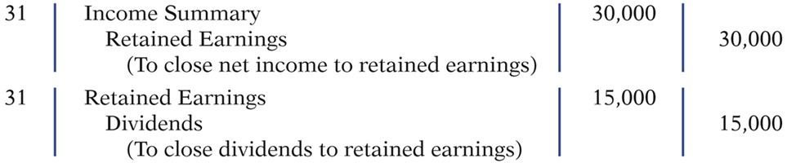
Closing Entries Close net income and dividends
L O 4

Slide 47
DO IT! 4: Closing Entries
The adjusted trial balance of Celine’s Sports Wear Shop at December 31 shows Inventory $25,000, Sales Revenue $162,400, Sales Returns and Allowances $4,800, Sales Discounts $3,600, Cost of Goods Sold $110,000, Rent Revenue $6,000, Freight-Out $1,800, Rent Expense $8,800, and Salaries and Wages Expense $22,000. Prepare the closing entries for the income statement accounts.
Dec. 31 | Sales Revenue | 162,400
 | Rent Revenue | 6,000
 | Income Summary |  | 168,400
L O 4

Slide 48
DO IT! 4: Closing Entries (Continued)
The adjusted trial balance of Celine’s Sports Wear Shop at December 31 shows Inventory $25,000, Sales Revenue $162,400, Sales Returns and Allowances $4,800, Sales Discounts $3,600, Cost of Goods Sold $110,000, Rent Revenue $6,000, Freight-Out $1,800, Rent Expense $8,800, and Salaries and Wages Expense $22,000. Prepare the closing entries for the income statements accounts.
Dec. 31 | Income Summary | 151,000
 | Cost of Goods Sold |  | 110,000
 | Sales Ret. and Allowances |  | 4,800
 | Sales Discounts |  | 3,600
 | Freight-Out |  | 1,800
 | Rent Expense |  | 8,800
 | Salaries and Wages Expense |  | 22,000
L O 4

Slide 49
Learning Objective 5-5
Multiple-Step Income Statement

Slide 50
Outline
Multiple-step
Single-step
Classified balance sheet

Slide 51
Multiple-Step
Multiple-Step Income Statement
Shows several steps in determining net income.
Two steps relate to principal operating activities.
Distinguishes between operating and non-operating activities.
L O 5

Slide 52
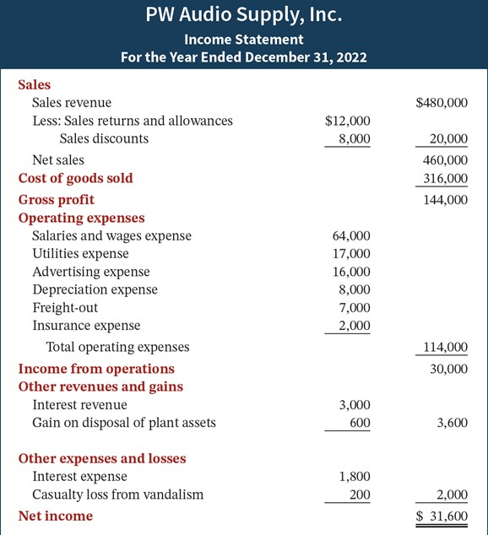
Multiple-Step Net sales
Key Items:
Net sales
L O 5

Slide 53
Multiple-Step Gross profit
Key Items:
Net sales
Gross profit
L O 5

Slide 54
Multiple-Step Operating expenses
Key Items:
Net sales
Gross profit
Operating expenses
L O 5

Slide 55
Multiple-Step Nonoperating activities
Key Items:
Net sales
Gross profit
Operating expenses
Nonoperating activities
L O 5

Slide 56
Multiple-Step Net income
Key Items:
Net sales
Gross profit
Operating expenses
Nonoperating activities
Net income
L O 5

Slide 57
Multiple-Step Income Statement Review Question
The multiple-step income statement for a merchandiser shows each of the following features except:
a. gross profit.
b. cost of goods sold.
c. a sales revenue section.
d. investing activities section.
L O 5

Slide 58
Single-Step Income Statement
Subtract total expenses from total revenues
Two reasons for using the single-step format:
Company does not realize any profit until total revenues exceed total expenses.
Format is simpler and easier to read.
L O 5

Slide 59
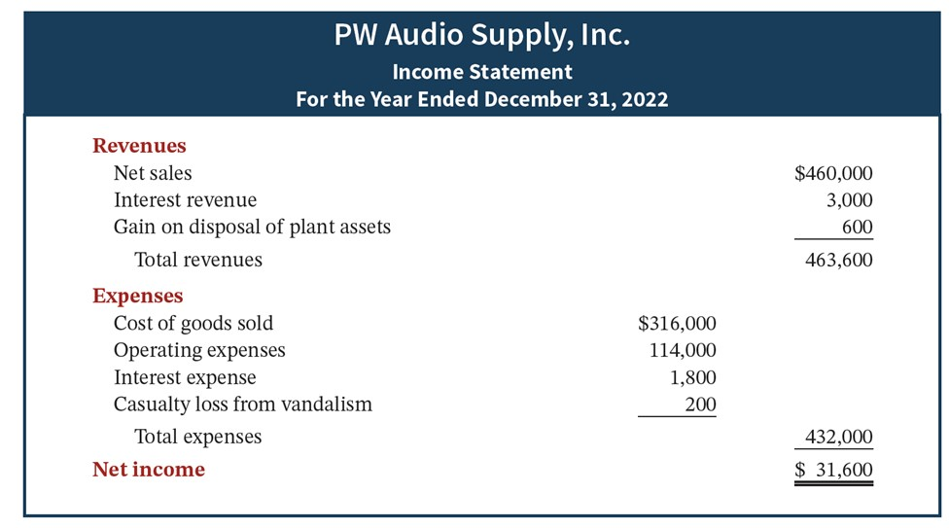
Single-Step Income Statement Example
L O 5

Slide 60
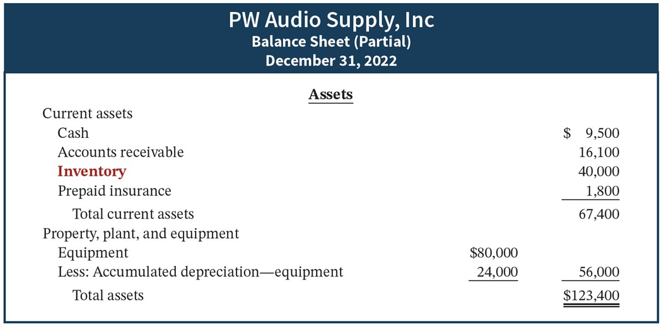
Classified Balance Sheet
L O 5

Slide 61
DO IT! 5: Multiple-Step Income Statement Information
The following information is available for Art Center Corp. for the year ended December 31, 2022.
Other revenues and gains | $ 8,000
Sales revenue | 462,000
Other expenses and losses | 3,000
Operating expenses | 187,000
Cost of goods sold | 147,000
Sales discounts | 20,000
Prepare a multiple-step income statement for Art Center Corp.
L O 5

Slide 62
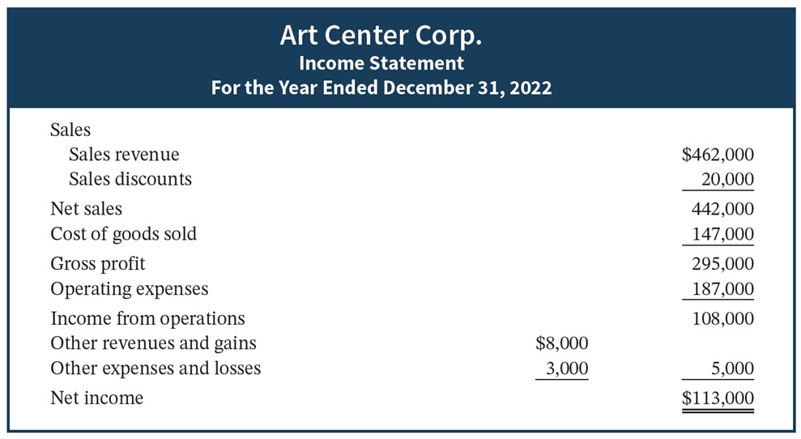
DO IT! 5: Multiple-Step Income Statement Solution
L O 5

Slide 63
Appendix 5b: Record Purchases and Sales Under a Periodic Inventory System
Determining Cost of Goods Sold Under a Periodic System
No running account of changes in inventory.
Ending inventory determined by physical count.
Cost of goods sold not recorded with each sale.

Slide 64
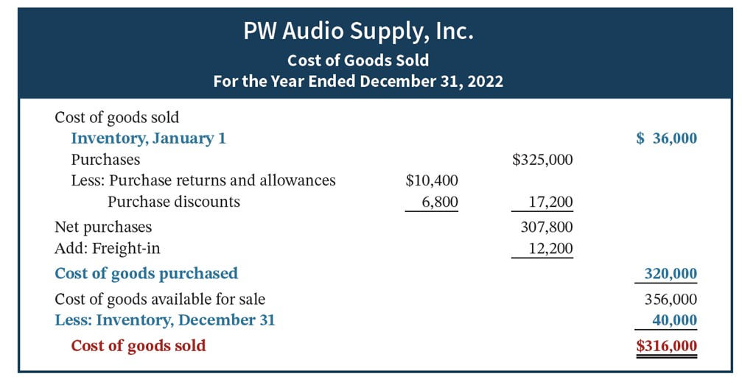
Determining Cost of Goods Sold Under a Periodic System

Slide 65
Recording Merchandise Transactions
Record revenues when sales are made.
Do not record cost of merchandise sold on the date of sale.
Physical inventory count determines:
Cost of merchandise on hand and
Cost of merchandise sold during the period.
Record purchases in Purchases account.
Purchase returns and allowances, Purchase discounts, and Freight costs are recorded in separate accounts.

Slide 66
Recording Purchases of Merchandise
Illustration: On the basis of the sales invoice and receipt of the merchandise ordered from PW Audio Supply, Sauk Stereo records the $3,800 purchase as follows.
May 4 | Purchases | 3,800
 | Accounts Payable |  | 3,800

Slide 67
Recording Purchases of Merchandise Freight Costs
Illustration: If Sauk pays Public Carrier Company $150 for freight charges on its purchase from PW Audio Supply on May 6, the entry on Sauk’s books is:
May 6 | Freight-In (Transportation-In) | 150
 | Cash |  | 150

Slide 68
Recording Purchases of Merchandise Purchase Returns and Allowances
Illustration: On May 8, Sauk Stereo returns $300 of goods to PW Audio Supply and prepares the following entry to recognize the return.
May 8 | Accounts Payable | 300
 | Purchase Returns and Allowances |  | 300

Slide 69
Recording Purchases of Merchandise Purchase Discounts
Illustration: On May 14 Sauk Stereo pays the balance due on account to PW Audio Supply, taking the 2% cash discount allowed by PW Audio for payment within 10 days. Sauk Stereo records the payment and discount as follows.
May 14 | Accounts Payable | 3,500
 | Purchase Discounts |  | 70
 | Cash |  | 3,430

Slide 70
Recording Sales of Merchandise
Illustration: PW Audio Supply, records the sale of $3,800 of merchandise to Sauk Stereo on May 4 as follows.
May 4 | Accounts Receivable | 3,800
 | Sales Revenue |  | 3,800
No entry is recorded for cost of goods sold at the time of the sale under a periodic system.

Slide 71
Recording Sales of Merchandise Sales Returns and Allowances
Illustration: To record the returned goods received from Sauk Stereo on May 8, PW Audio Supply records the $300 sales return as follows.
May 8 | Sales Returns and Allowances | 300
 | Accounts Receivable |  | 300

Slide 72
Recording Sales of Merchandise Sales Discounts
Illustration: On May 14, PW Audio Supply receives payment of $3,430 on account from Sauk Stereo. PW Audio honors the 2% cash discount and records the payment of Sauk’s account receivable in full as follows.
May 14 | Cash | 3,430
 | Sales Discounts | 70
 | Accounts Receivable |  | 3,500

Slide 73
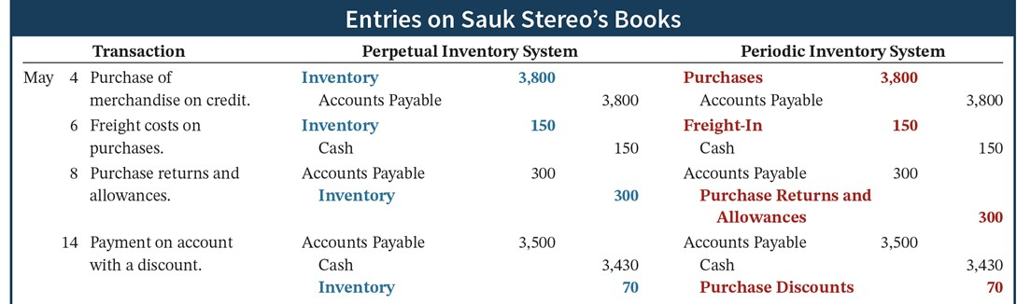
Recording Sales of Merchandise Comparison of Entries

Slide 74
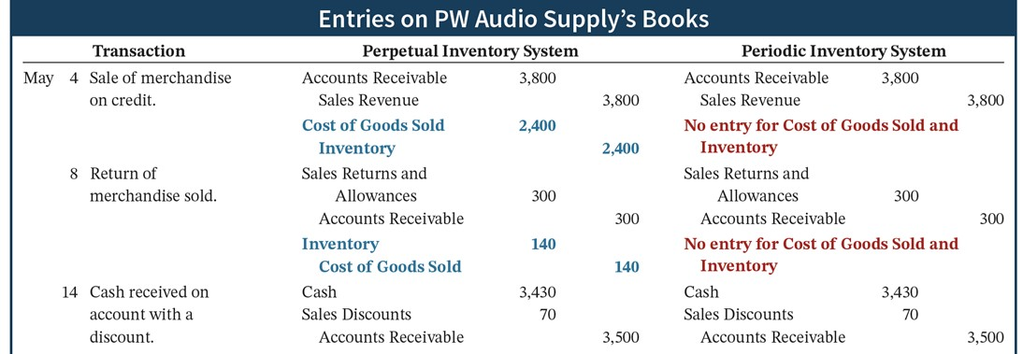
Recording Sales of Merchandise Comparison of Entries (Continued)

Slide 75
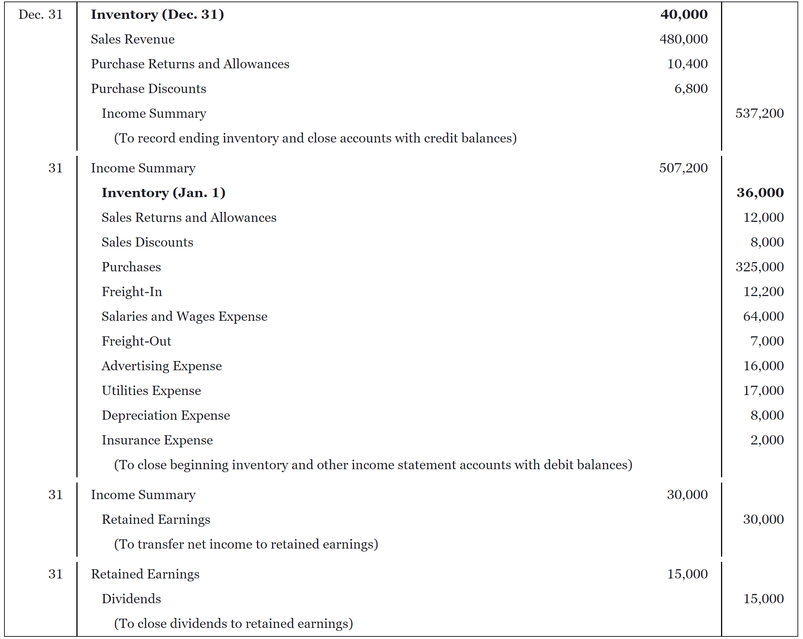
Closing Entries for Periodic System

